Slide 1
Data Structures and Algorithms

Slide 2

Chapter four: Linked Lists
This chapter covers:
  Singly linked lists
  Doubly linked lists

Slide 3
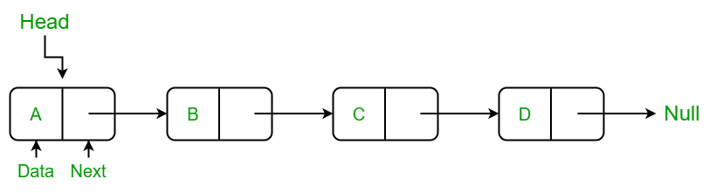
Creating Linked Lists in C++
A linked list is a data structure which is built from structures and pointers.
It forms a chain of "nodes" with pointers representing the links of the chain and holding the entire thing together.
Graphically,

Slide 4
..
This linked list has four nodes in it, each with a link to the next node in the series.
The last node has a link to the special value NULL, which any pointer (whatever its type) can point to, to show that it is the last link in the chain.
There is also another special pointer, called Start, which points to the first link in the chain so that we can keep track of it.

Slide 5
...
l) Single Linked List
Create linked list
struct node {
item// Name of up to 20 chars
struct node *nxt; // Pointer to next node
};
node *temp,*temp2;
node *start_ptr = NULL;
//start_ptr will permanently point to the start of the list

Slide 6
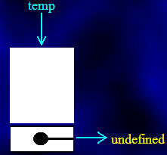
ii) Storing and accessing Data files
Single Linked List
  Firstly, we declare the space for a pointer item and assign a temporary pointer to it. This is done using the new statement as follows:
  temp = new node;

Slide 7
Create node and insert in the front…
temp=new node;
temp->next=NULL;
cout<<"Enter the item\n";
cin>>temp->item;
if(start==NULL)
start=temp;
else
{
temp->next=start;
start=temp;}

Slide 8
iii) The full code for adding a node at the end of the list is shown below, in its
temp=new node;
cout<<"Enter the item\n";
cin>>temp->item;
temp->next=NULL;
if(start==NULL)
start=temp;
else
{
temp2=start;
while(temp2->next!=NULL)
{
temp2=temp2->next;
}
temp2->next=temp;
}

Slide 9
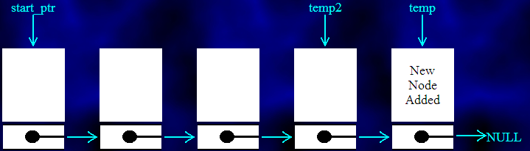
…
Graphically

Slide 10
…
Single Linked List:
Having added one or more nodes, we need to display the list of nodes on the screen.
This is comparatively easy to do. Here is the method:
  Set a temporary pointer to point to the same thing as the start pointer.
  If the pointer points to NULL, display the message "End of list" and stop.
  Otherwise, display the details of the node pointed to by the start pointer.
  Make the temporary pointer point to the same thing as the nxt pointer of the node it is currently indicating.
  Jump back to step 2.

Slide 11
iv) Traversing (Displaying the list of nodes)
if(start==NULL){
cout<<"Nothing to display\n";
}
else
{
temp2 =start;
while(temp2!=NULL)
{
cout<<temp2->item<<" ";
temp2=temp2->next;
}

Slide 12
v) Deleting a node from the list
When it comes to deleting nodes, we have three choices:
  Delete a node from the start of the list,
  delete one from the end of the list, or
  delete one from somewhere in the middle.
When a node is deleted, the space that it took up should be reclaimed. Otherwise the computer will eventually run out of memory space. This is done with the delete instruction:
  delete temp; // Release the memory pointed to by temp

Slide 13
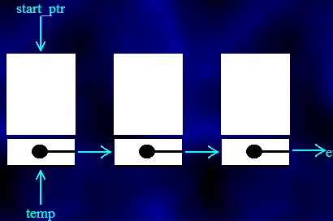
…
However, we can't just delete the nodes willy-nilly as it would break the chain.
We need to reassign the pointers and then delete the node at the last moment.
Here is how we go about deleting the first node in the linked list:
  temp = start_ptr; // Make the temporary pointer identical to the
  // start pointer

Slide 14
…
Now that the first node has been safely tagged (so that we can refer to it even when the start pointer has been reassigned), we can move the start pointer to the next node in the chain:
start_ptr = start_ptr->nxt; // Second node in chain.

Slide 15
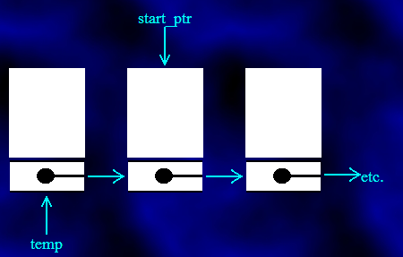

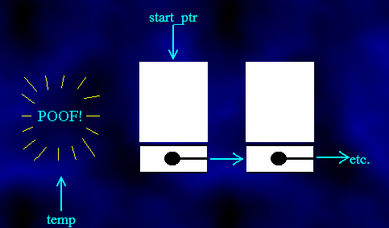
…
.

Slide 16
Here is the function that deletes a node from the start:
void delete_start_node()
{
node *temp;
temp = start_ptr;
start_ptr = start_ptr->nxt;
delete temp;
}

Slide 17
Deleting a node from the end
Look at the start pointer. If it is NULL, then the list is empty, so print out a "No nodes to delete" message.
Make temp1 point to whatever the start pointer is pointing to.
If the nxt pointer of what temp1 indicates is NULL, then we've found the last node of the list, so jump to step 7.
Make another pointer, temp2, point to the current node in the list.
Make temp1 point to the next item in the list.
Go to step 3.
If you get this far, then the temporary pointer, temp1, should point to the last item in the list and the other temporary pointer, temp2, should point to the last-but-one item.
Delete the node pointed to by temp1.
Mark the nxt pointer of the node pointed to by temp2 as NULL - it is the new last node.

Slide 18
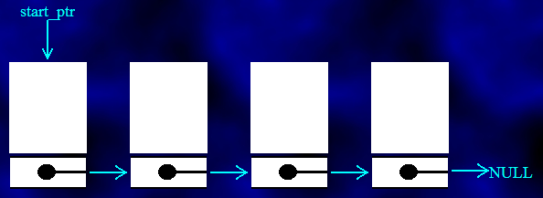
Suppose we want to delete the last node from this list:

Slide 19
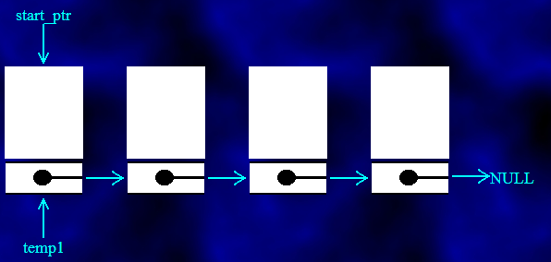
Let's get straight on with step2 - set the pointer temp1 to the same as the start pointer:

Slide 20
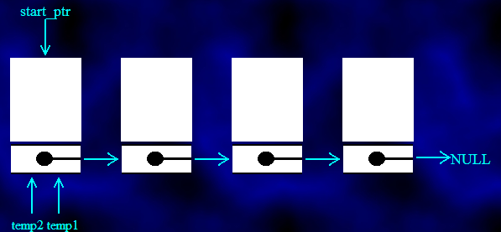
The nxt pointer from this node isn't NULL, so we haven't found the end node. Instead, we set the pointer temp2 to the same node as temp1

Slide 21
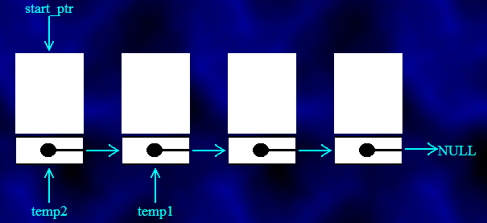
and then move temp1 to the next node in the list:

Slide 22
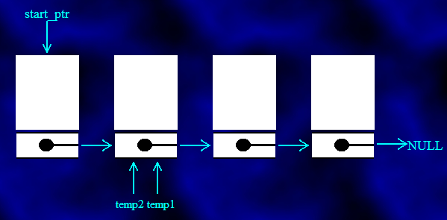
Going back to step 3, we see that temp1 still doesn't point to the last node in the list, so we make temp2 point to what temp1 points to

Slide 23
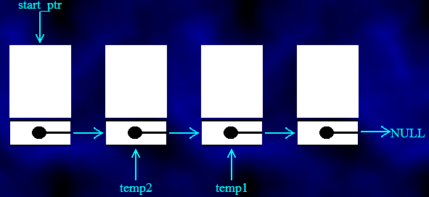
and temp1 is made to point to the next node along:

Slide 24
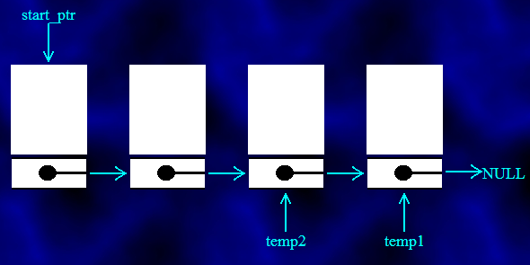
Eventually, this goes on until temp1 really is pointing to the last node in the list, with temp2 pointing to the penultimate node:

Slide 25
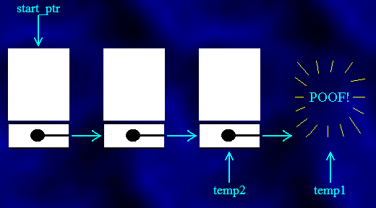
Now we have reached step 8. The next thing to do is to delete the node pointed to by temp1

Slide 26
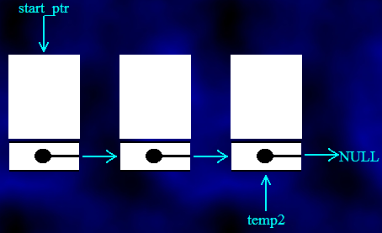
and set the nxt pointer of what temp2 indicates to NULL:

Slide 27
The code to delete last node.
void delete_end_node()
{ node *temp1, *temp2;
if (start_ptr == NULL) cout << "The list is empty!" << endl;
Else
{ temp1 = start_ptr;
  if (temp1->nxt == NULL)
  { delete temp1;
  start_ptr = NULL;
  } Else
  { while (temp1->nxt != NULL)
  { temp2 = temp1;
  temp1 = temp1->nxt;
  }
  delete temp1;
  temp2->nxt = NULL;
  }
  }
  }

Slide 28
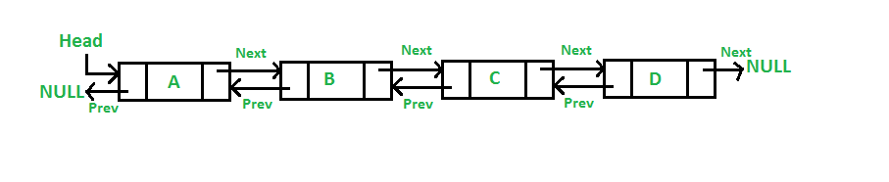
Doubly Linked List
A doubly linked list is one where there are links from each node in both directions.
Notes:
1

Slide 29
Definitions
struct dllstud{
int age;
char name[20];
char dept[20];
dllstud *nxt,*prv;
};
dllstud *start=NULL,*last=NULL;

Slide 30
Storing and accessing Data files
cout<<"enter age\n";
cin>>temp->age;
cout<<"enter name \n";
cin>>temp->name;
/*cout<<"enter dept\n";
cin>>temp->dept;

Slide 31
Adding a node to the end of a list
temp->nxt=NULL;
temp->prv=NULL;
if(start==NULL||last==NULL)
start=last=temp;
else
{
temp->nxt=start;
start->prv=temp;
start=temp;
}
cout<<temp->name<<" is inserted ";

Slide 32
Display a node
if(start==NULL||last==NULL)
cout<<"list is empty \n";
else {
temp2=start;
while(temp2!=NULL)
{
cout<<temp->age<<" "<<temp->name<<"=>";
temp2=temp2->nxt;
}
}

